Slide 1
Parts of a whole
-DRISHTI DOSHI
Section j

Slide 2
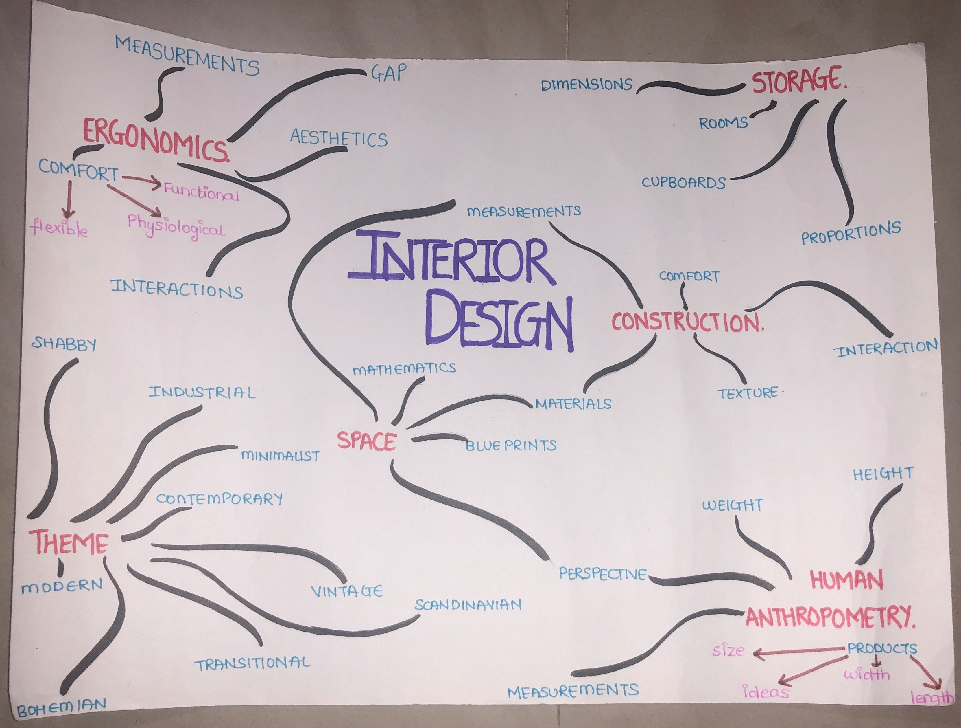
Mind maps
1] INTERIOR DESIGN
Interior design is the art and science of enhancing the interior of a building to achieve an aesthetically pleasing environment.
Some of the categories are Ergonomics, Human Anthropometry, Construction, Storage, Space and Theme
There are common elements like material, dimensions, proportions for a few categories.

Slide 3
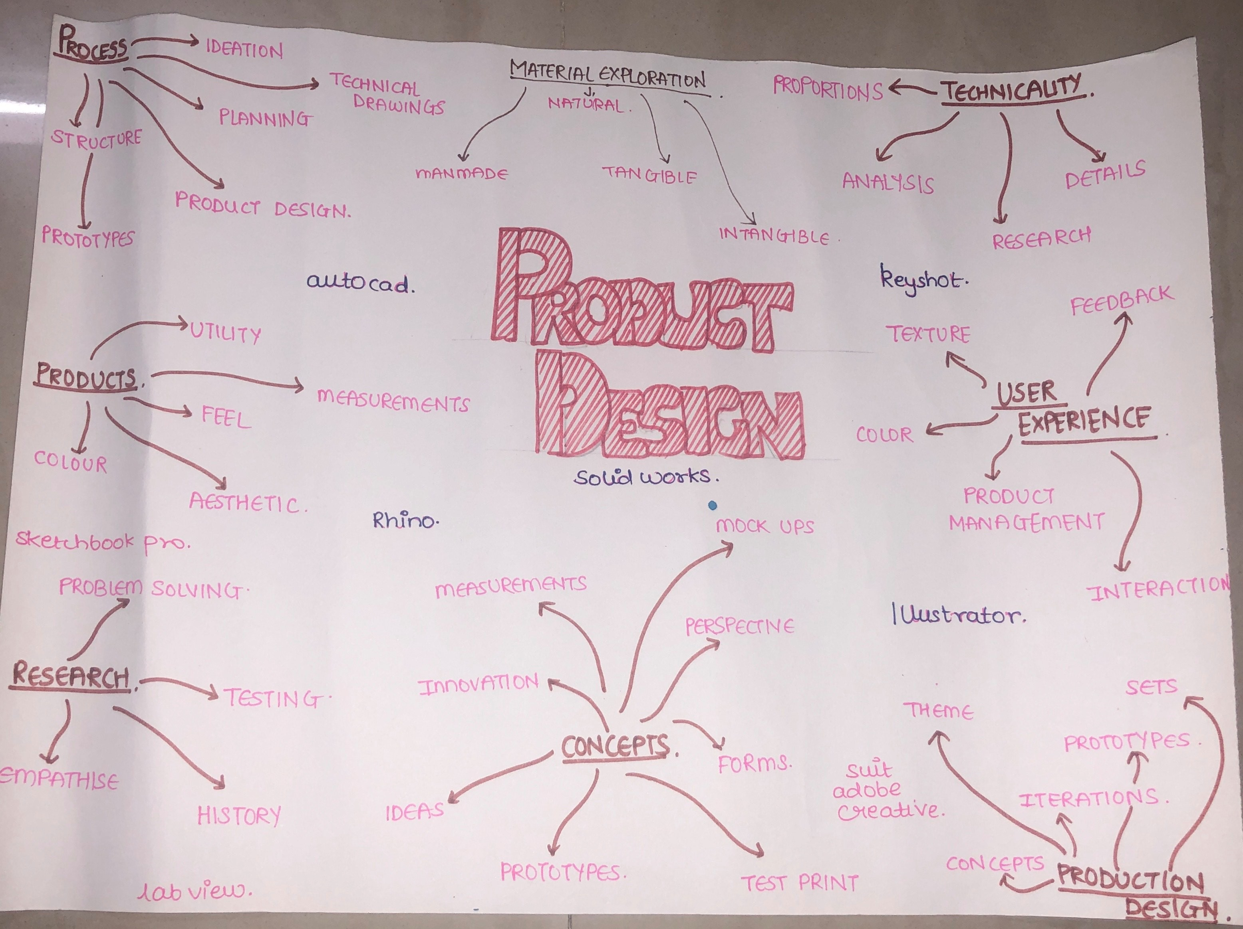
2] PRODUCT DESIGN
Product design is to create a new product to be sold by a business to it’s customers.
Some of the categories are Process, Products, Research , Technicality, User Experience, Production Design, Concepts and Material Exploration
Software’s used in Product design :- Rhino, Solid works, Illustrator, Key shot, AutoCAD.

Slide 4
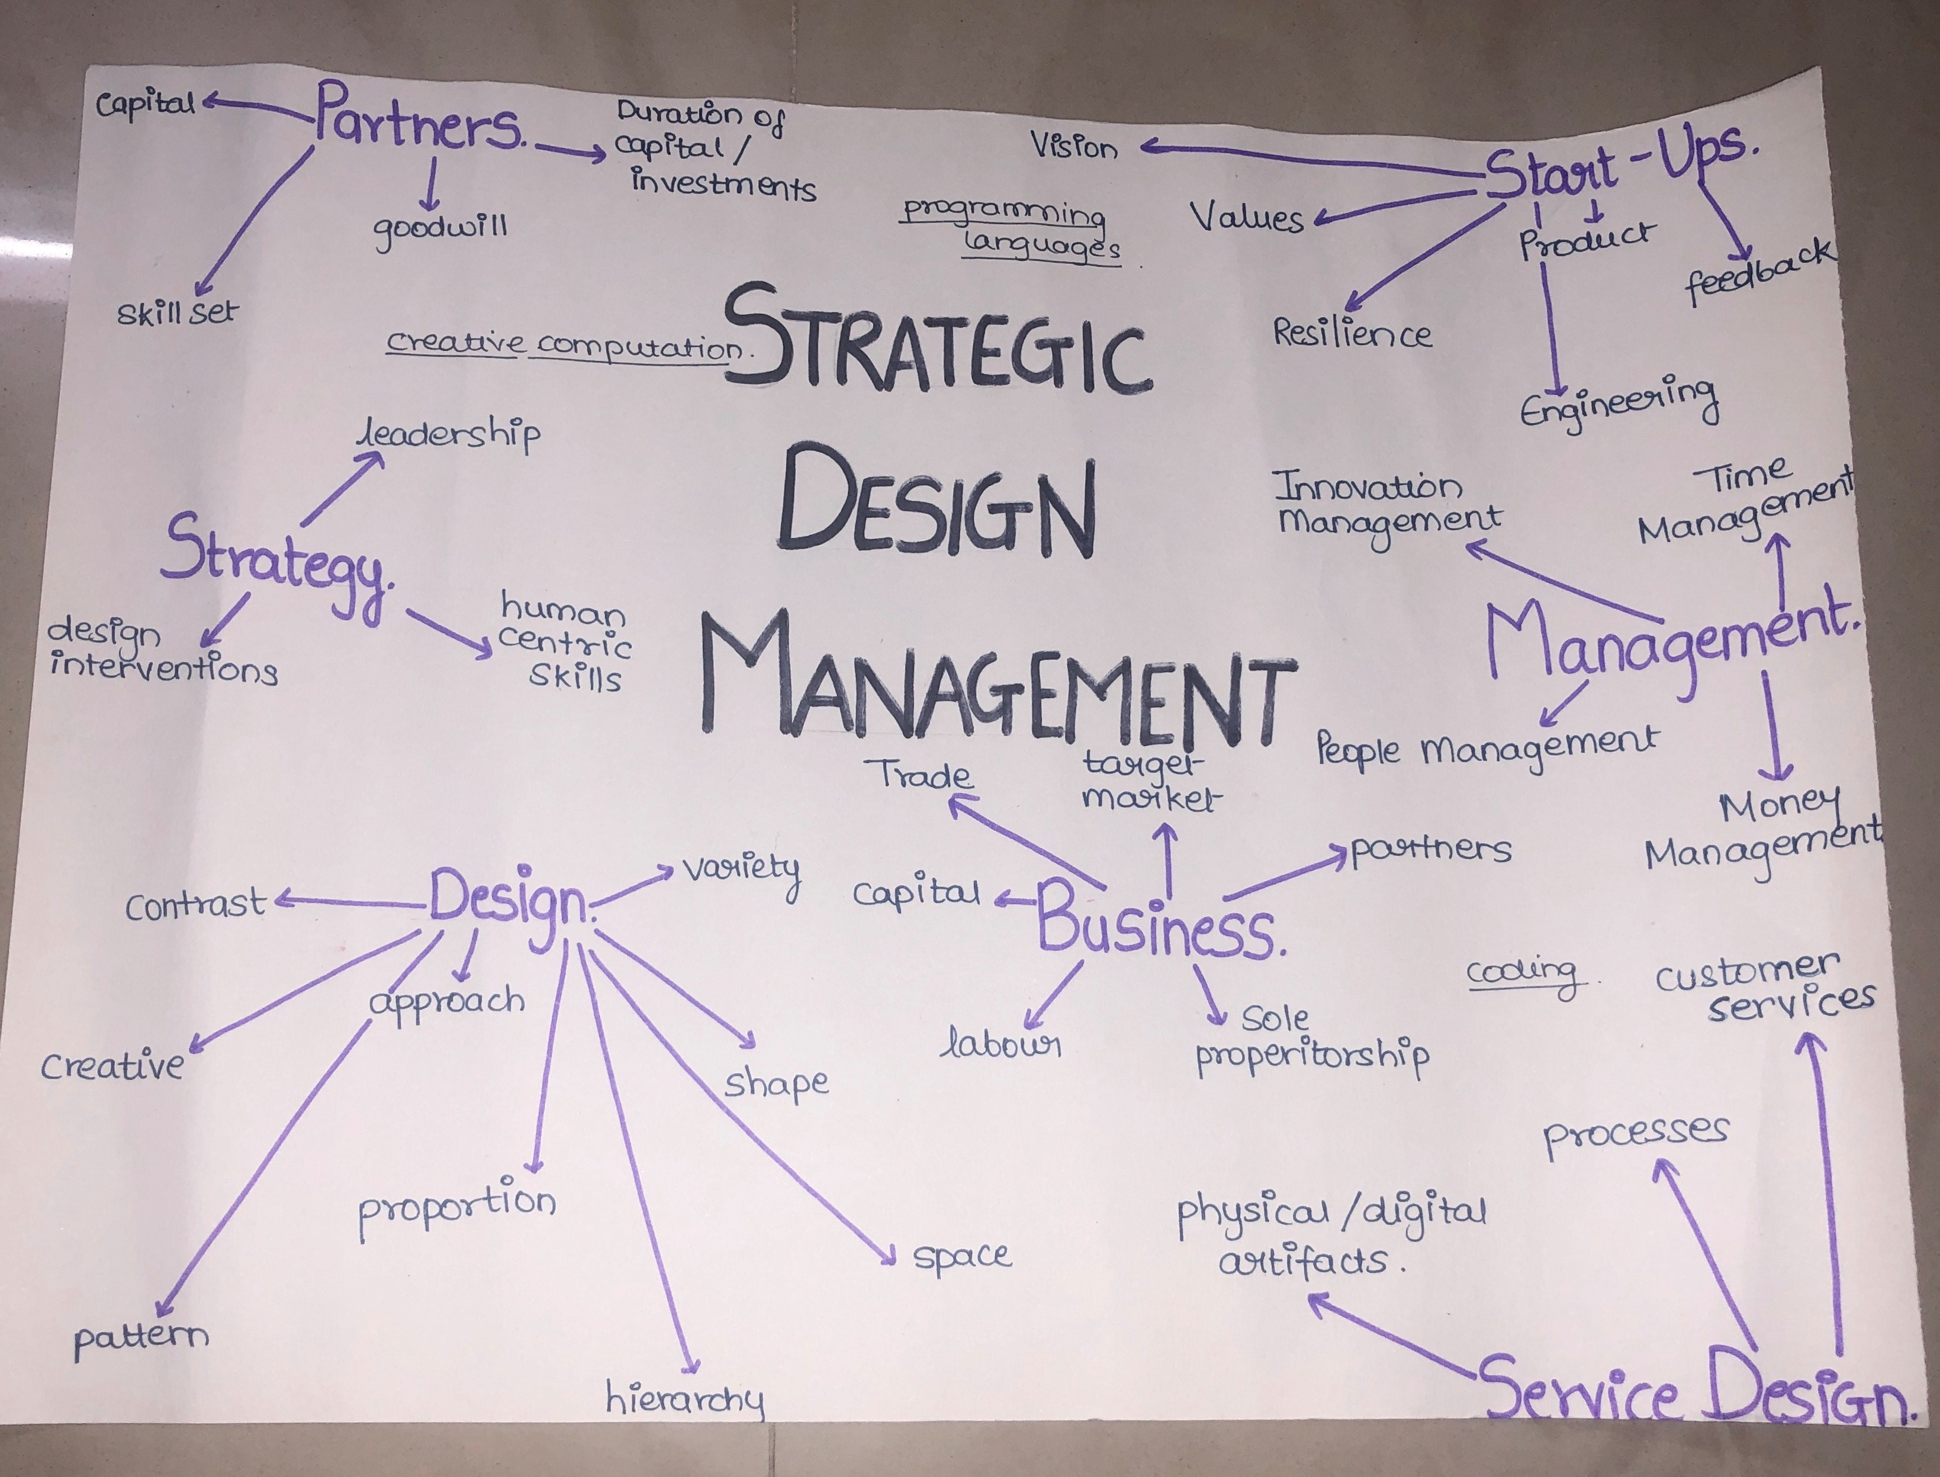
3] Strategic design and management
Strategic design is the application of future-oriented design principles in order to increase an organization's innovative and competitive qualities.
Some of the categories are Partners, Strategy, Design, Business, Service Design, Management and Start Ups

Slide 5
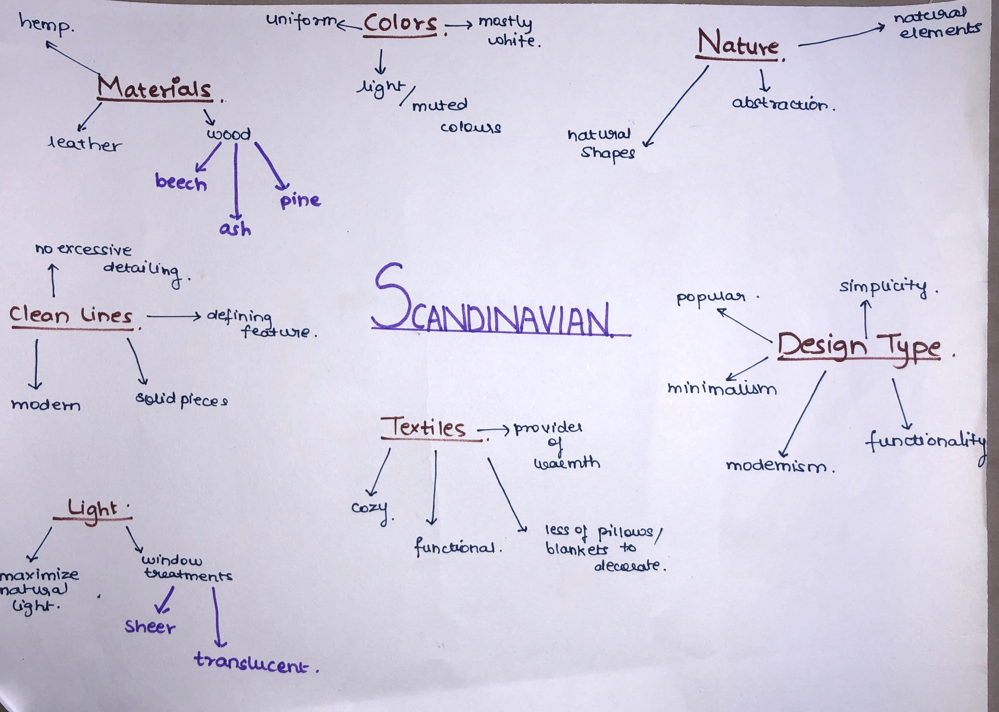
MIND MAP B

Slide 6
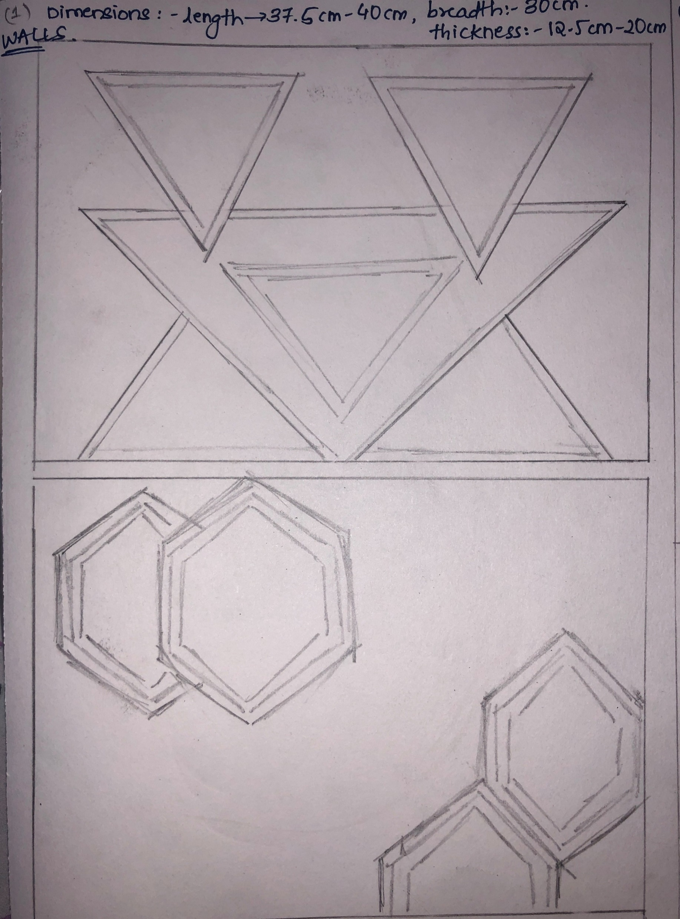
ITERATIONS BASED ON SCANDINAVIAN THEME
The first iteration is of walls.
The element which the iterations are based on is Natural shapes.
Scandinavian theme has plain solid walls without any design. This ideation shows different wall designs using natural shapes

Slide 7
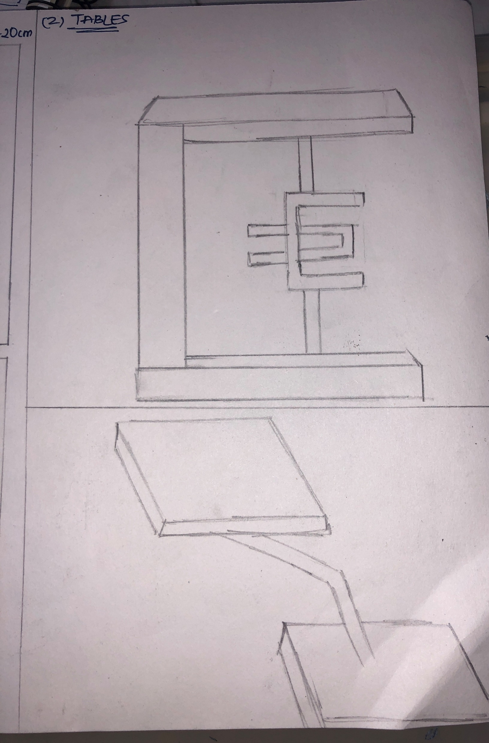
The second iteration is of tables.
Scandinavian theme has tables which have basic shapes like circle, rectangle or square,
The Ideation which I came up with shows tables with unconventional shapes

Slide 8
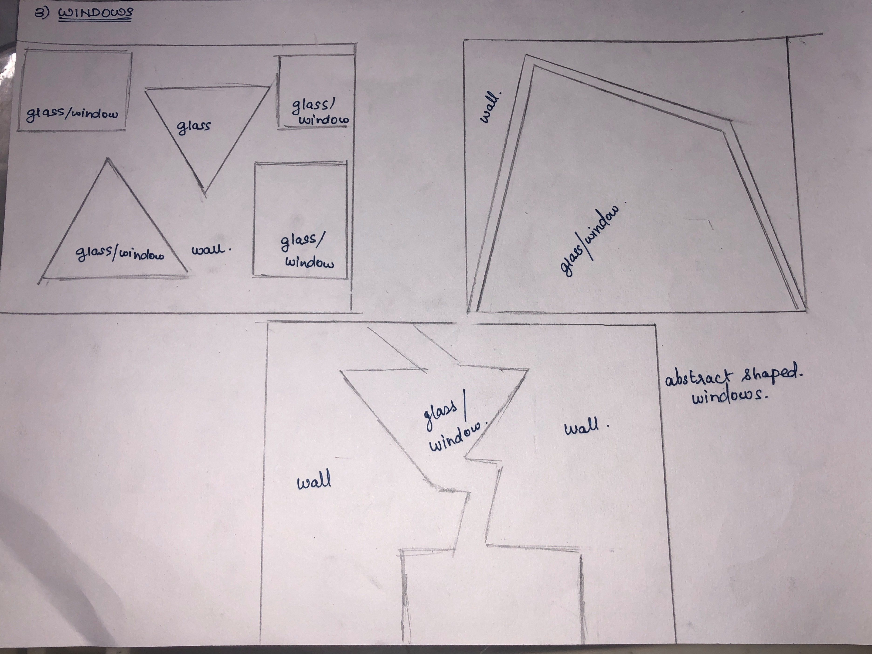
The third iteration is of windows.
Since Scandinavian has very basic windows my ideation was to come up with windows that have irregular shapes and designs.

Slide 9
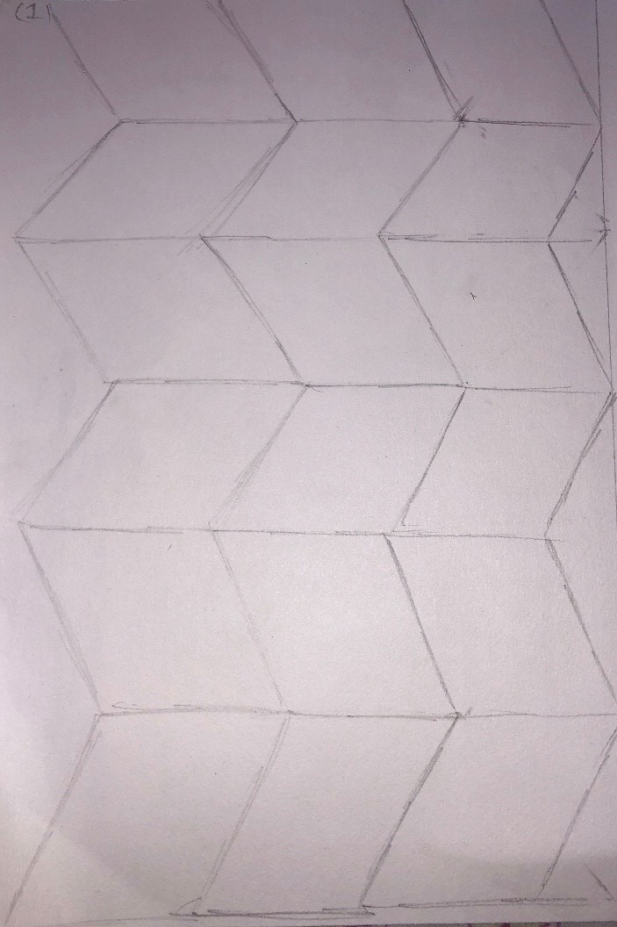
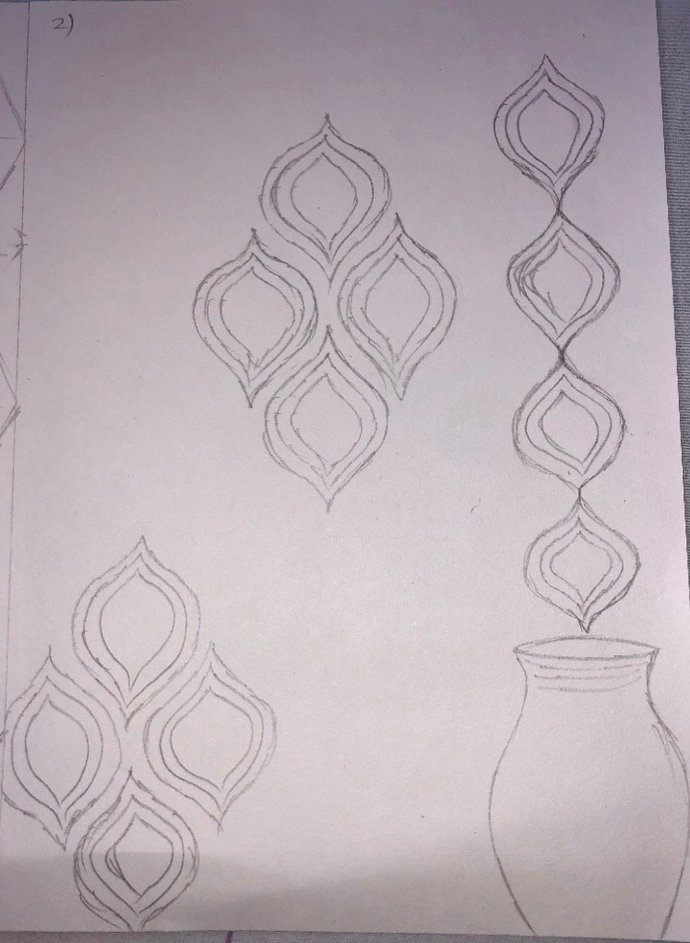
Next 5 iterations
The iteration which I decided to go ahead with for my final prototype was walls. I made 5 different iterations of wall design using various shapes.

Slide 10
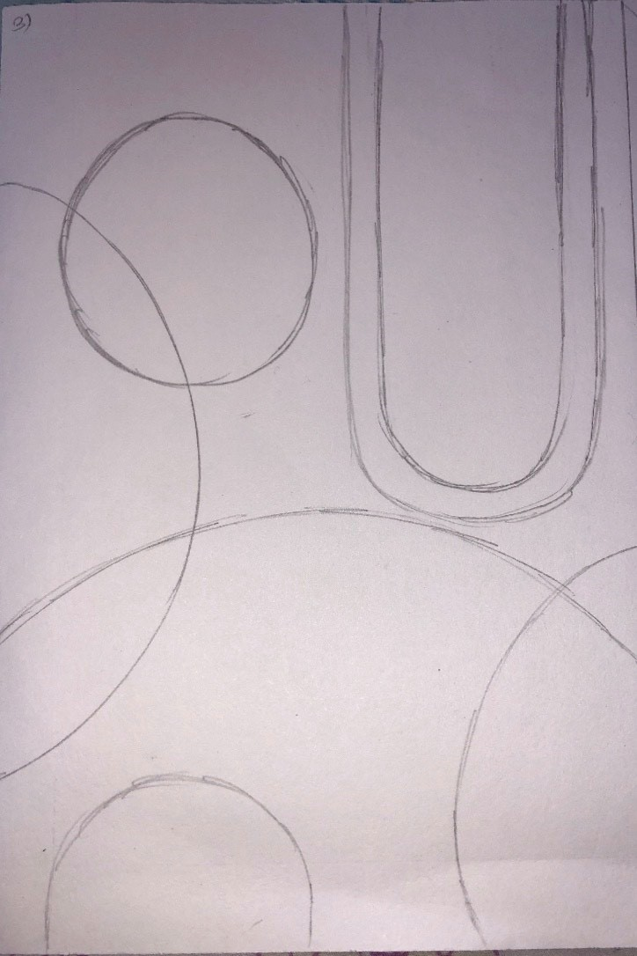
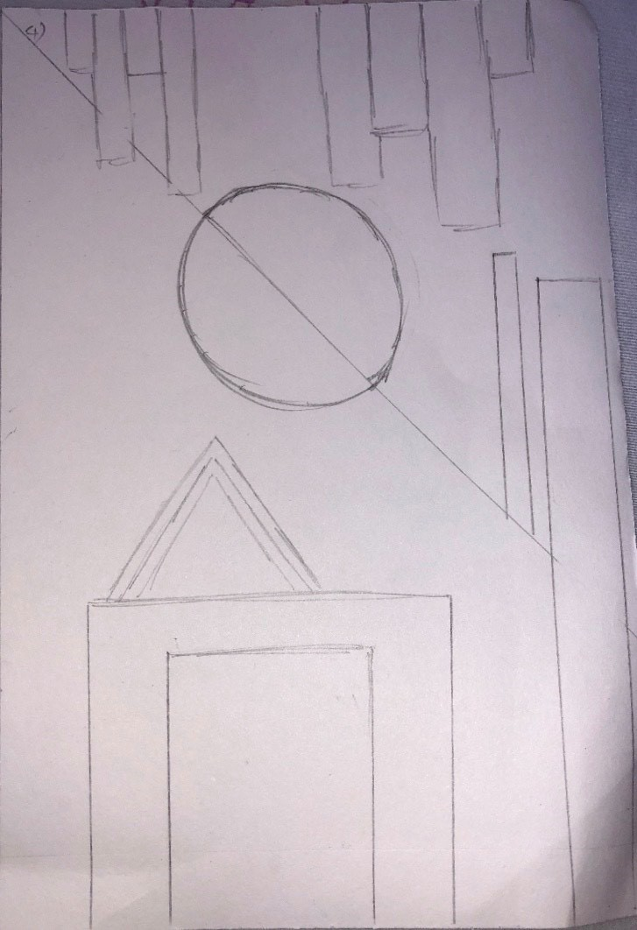
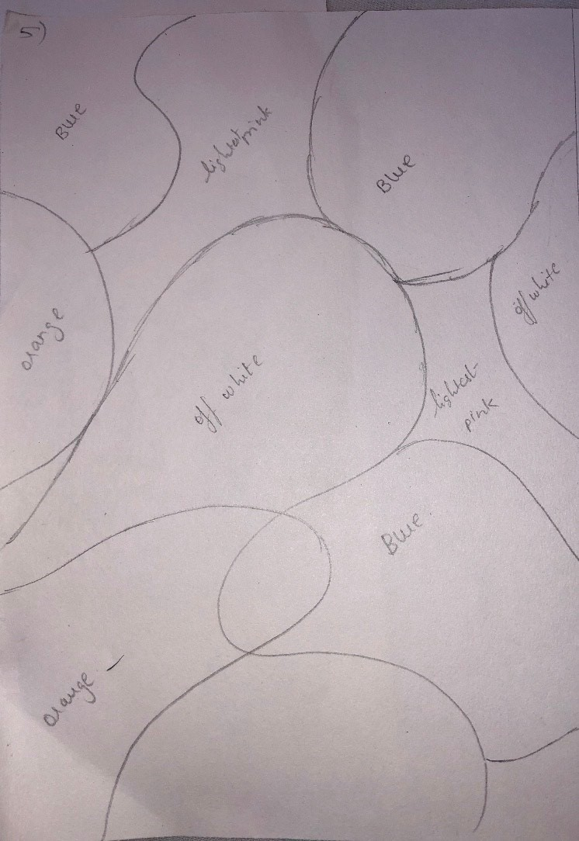

Slide 11
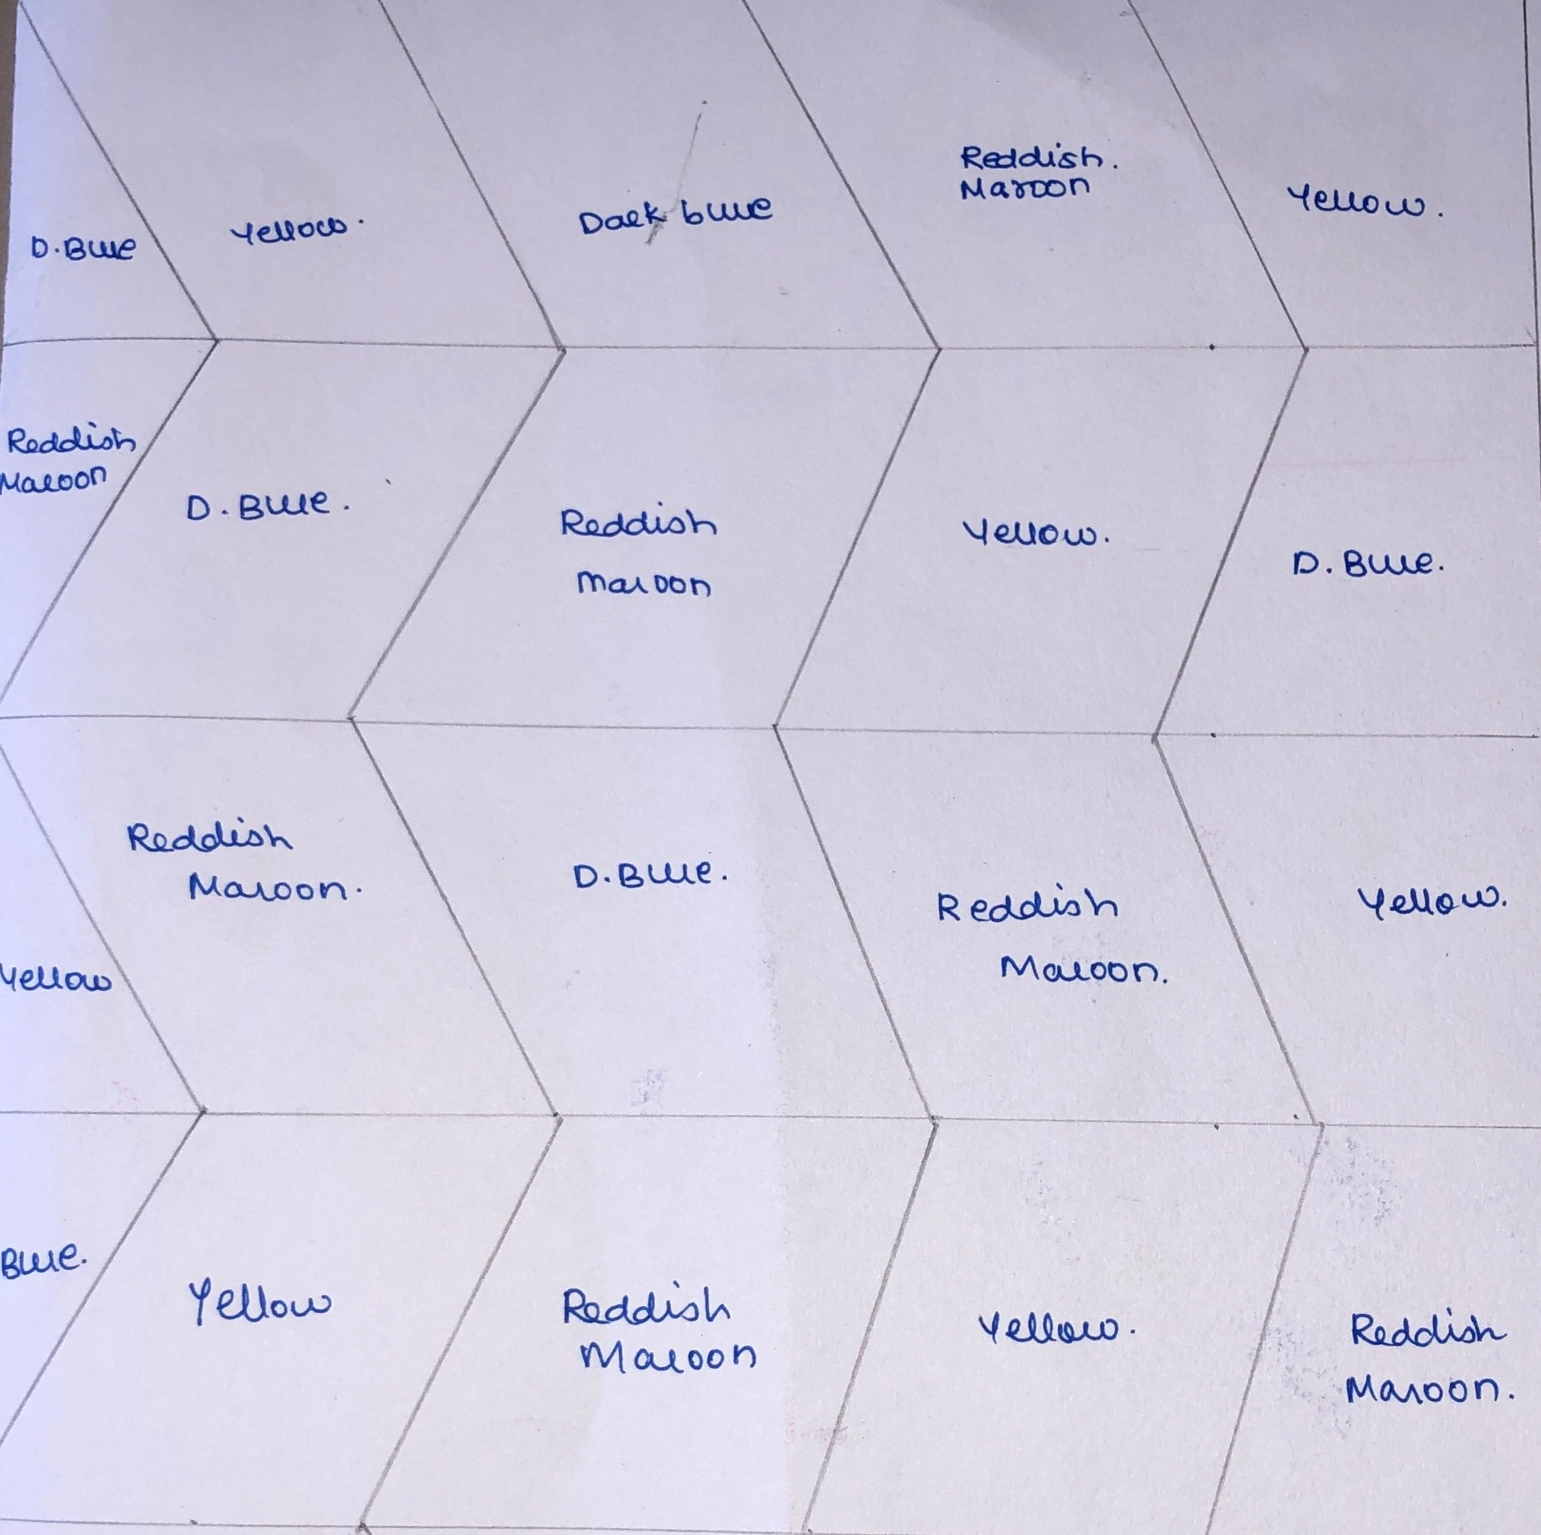
FINAL ITERATION
This was the final iteration for the prototype.
Since Scandinavian theme follows a monochromatic colour scheme for their walls. My ideation is to design a wall with patterns along with adding an element of natural shapes to it. Instead of adding literal shapes I decided on making it a bit abstract and continuous. The colours I thought of adding to the pattern are yellow , dark blue and reddish maroon to make the wall look bright.

Slide 12
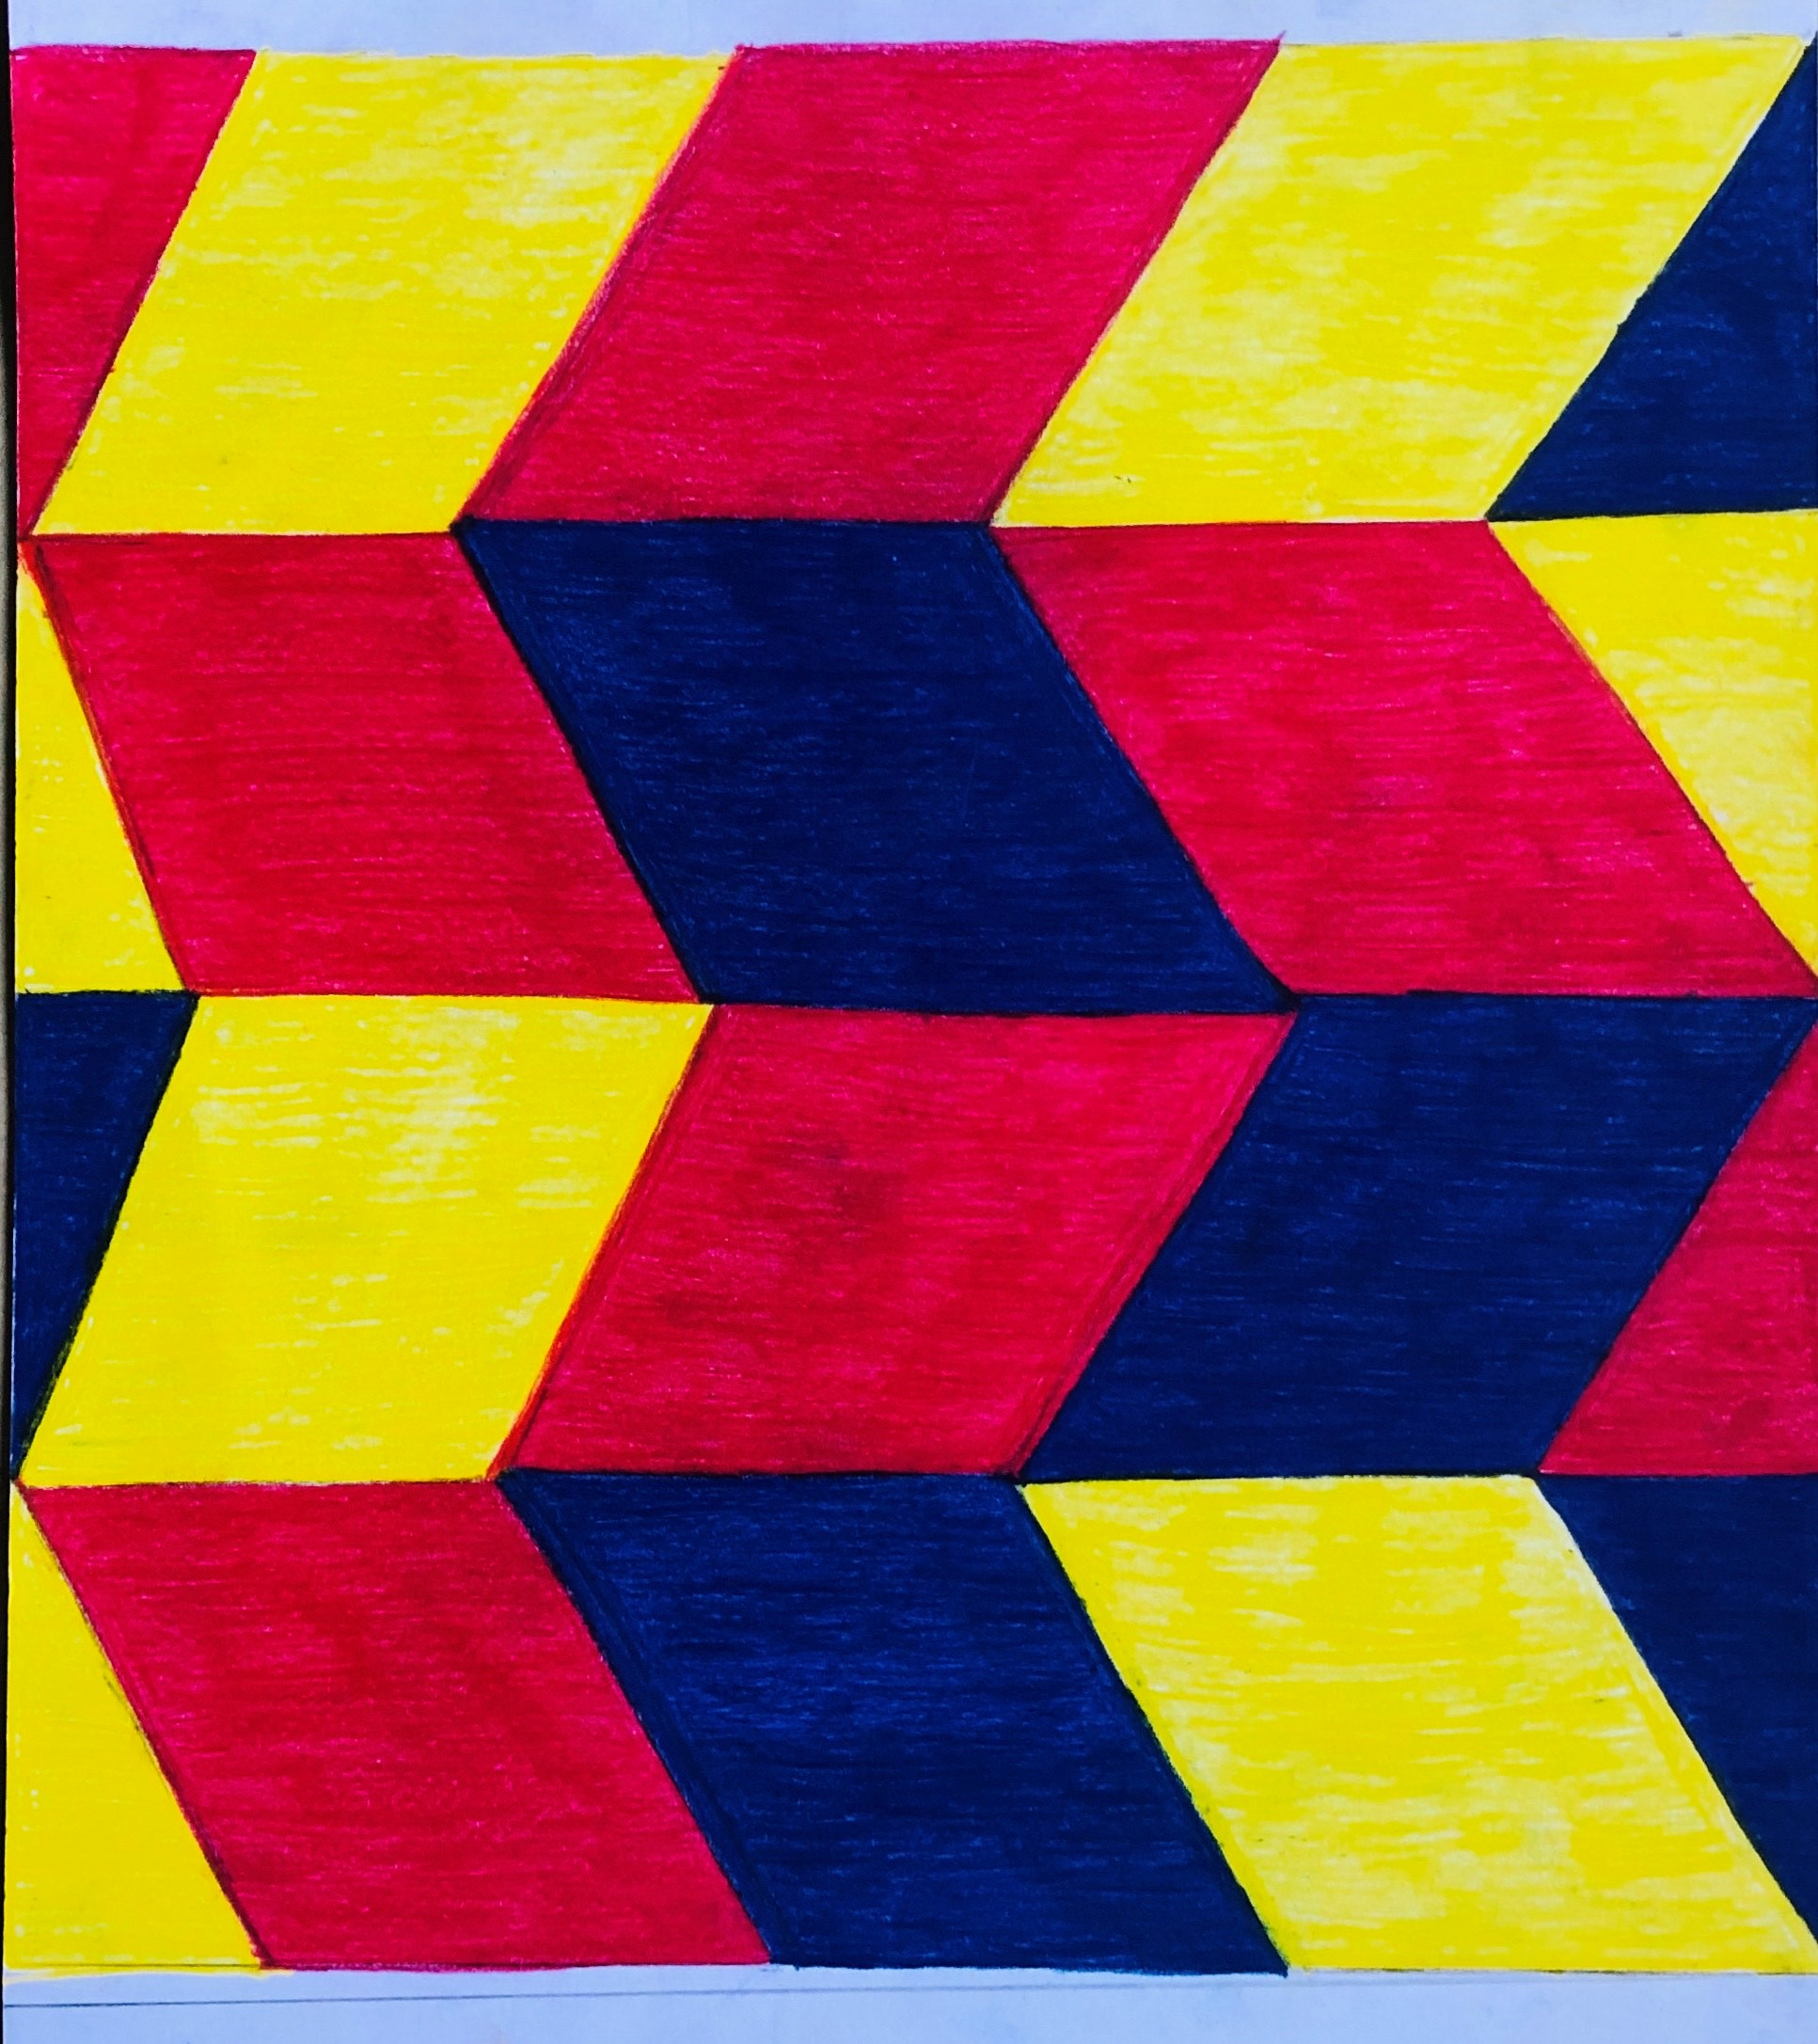
WALL MURAL
Materials used :- cardboard, paints and colour pencils

